Slide 1
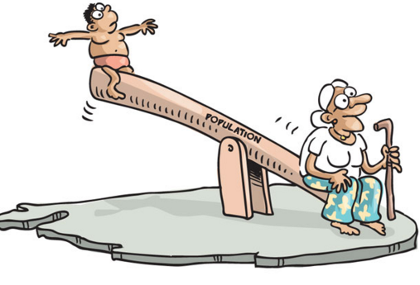
Patienten-orientierte Versorgung Ein Blick in die Zukunft Kanada 2030
Dr Thuy-Nga Pham, MD, MSc, CCFP
Assistant Professor, Department of Family and Community Medicine, University of Toronto, Canada
BMC Berlin 22. Januar 2019

Slide 2
Mit Würde alt werden
Vergleich Kanada – Deutschland
Patient-Orientierte Versorgung
Multidisziplinäre Teams
Ein konkretes Beispiel - South East Toronto Family Health Team:
Älter werden im eigenen Haus: Haus Visiten als Team, Virtual Care

Slide 3
Gesundheit in einer Gesellschaft des längeren Lebens

Slide 4
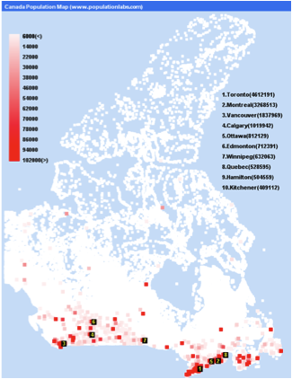
Haben Kanada und Deutschland irgendetwas gemeinsam?
Bevölkerung:
Deutschland 80 Millionen
Kanada 35 Millionen (14 Millionen in Ontario)
65 years und älter:
Deutschland 20%
Kanada 15%

Slide 5
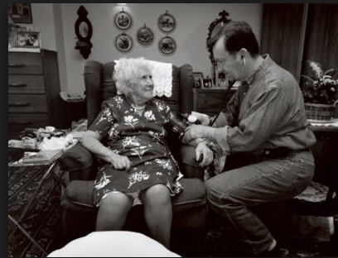
Ältere Patienten mit chronischen Erkrankungen möchten nicht als Nummer behandelt werden
“Würdevoll alt werden”
Dr Mark Novaczynski
House Calls Program Toronto
Sinai Health Systems

Slide 6
What ‘Patient-Centred’ Should Mean: Confessions of an Extremist
Don Berwick, Health Affairs 2009

Slide 7
Multidisziplinäre Teams in der Primärversorgung
Prävention und Patienten-orientierte Versorgung spielen heute eine grössere Rolle.
Zunehmender Anteil an älteren Patienten mit Multimorbidität.
Unterversorgung an Ärzten, vor allem im Ländlichen.

Slide 8
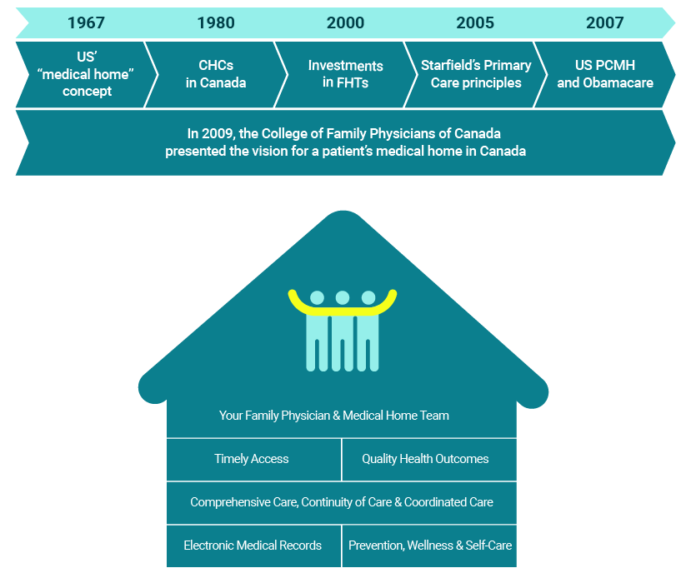

Slide 10
Multidisziplinäre Teams in der Medizin “The right provider at the right time”

Slide 11
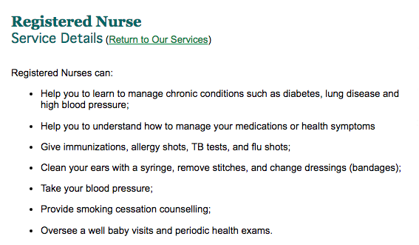
Multidisziplinäres Team Beispiel: Die Rolle Krankenpfleger/in

Slide 12
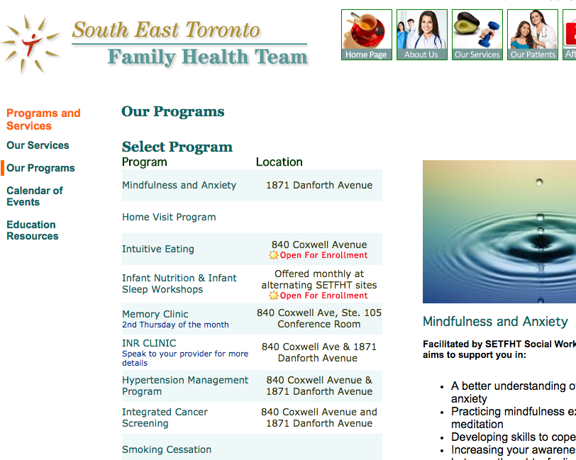

Slide 13
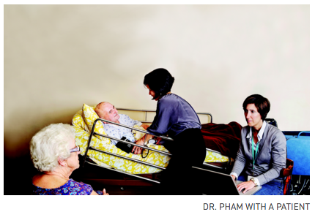
Patienten wünschen es sich, zu Hause zu leben und – zu sterben

Slide 14
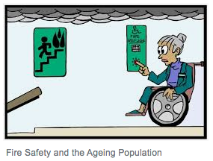
Integrated Home Based Primary Care (IHBPC)
Vision:
Build a system of care that provides point of care integration for homebound adults.
Mission
To maintain patients in the community by providing continuity and comprehensiveness of primary and community care for homebound patients
To deliver humane care that respects older adults’ choices to live at home and to support their families
To improve quality of care while reducing health care costs

Slide 15
IHBPC Medical Services
Key Clinical Services – Ideal State
Key Supports – Ideal State
Chronic Disease Management
Access to specialty care
Acute medical care
End of Life Care and Advance Care Planning
Linkage to community, caregiver support
24 hours x 7 days
Single point of access
Clinical and community coordination
In home lab services
Telemedicine support
IHBPC Team Members
Physician
Nurse Practitioner
Physician Assistant
Nurse
Pharmacist
Care Coordinator
Occupational and Physical Therapists
Social Worker
Community Support Service workers
Notes:
IMPACT team – telemedicine
List out all professions

Slide 16
Was Patienten und ihre Familien sagen
Patienten
Familienmitglieder
…Knowing that somebody cares, that there are services that I can access… makes me feel comfortable… there have been cases in these two buildings where ladies have died and nobody’s known that they’re dead for a few days…”
Consequently, the word “grateful” came up repeatedly (nine times) in the data referring to how participants felt being able to receive care in the “comfort of their own home” (P21). “
Smith-Carrier, T., et al. It ‘makes you feel more like a person than a patient’: patients’ experience receiving home-based primary care (HBPC) in Ontario, Canada. Health and Social Care in the Community (2016) doi: 10.1111/hsc.12362.
I like the way they have their team organized…like, you phone and you know there’s only a few people who handle the calls, so they recognize your voice, so they’ll know, oh okay it’s time for this or that…you’re not going through a whole explanation of the person’s care and things, so I like the way they have it organized. It’s very, well, efficient.”
Smith-Carrier, T. et al. ‘It’s not just the word care, it’s the meaning of the word…(they)actually care’: Caregivers’ perceptions of home-based primary care in Toronto, Ontario. Ageing and Society, 1-22, 2017.
Notes:
“P14 described experiencing “peace of mind” as a result of receiving HBPC. She explains,
“The nurturing of relationships, as this participant implicitly voiced, contributes to more efficient care.

Slide 17
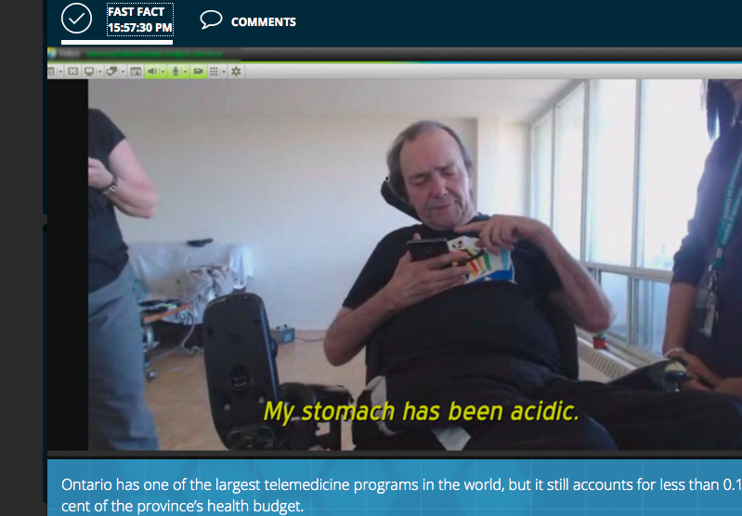
Telemedicine, Vital Sign Monitoring – “Because it is 2016”
Al:
Im Rollstuhl und findet es schwer, im Winter den Bus zu meiner Klinik zu nehmen.

Slide 18
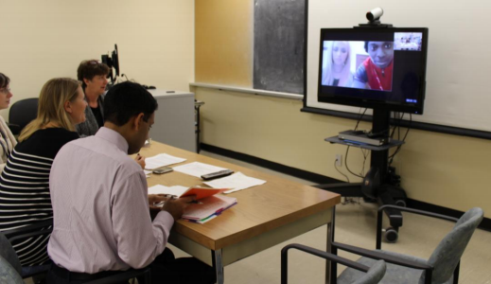
Virtual Care 2020

Slide 19
Barrieren 2019

Slide 20
10 Jahre Erfahrung mit Family Health Teams Wichtige Erfolgsbedingungen
Patienten und die Gemeinde müssen von Anfang an eingebunden werden in die Plannung.
Es ist wichtig, dass Ärzte in Führungsstellen an Entscheidungen teilnehmen.
Qualität kann gemessen werden für jedes Klinik Zentrum.
High Performing Teams sind massgebend.
Information Technology und Datenteilung sind wichtig für intersektorale Kollaboration.

Slide 21
Fragen?
Email: Thuynga.pham@utoronto.ca
Twitter: @PhamTia

